Slide 1
Cyber Security and Georgia. New Challenges
Internet Development Initiative
Vladimer Svanadze

Slide 2
According to the Global Cybersecurity Index 2017 reported by the International Telecommunication Union (ITU), Georgia was placed 8th in the World, 2nd in the Europe, and 1st in the CIS
Top three ranked countries in Commonwealth of Independent States (CIS)
Source: Global Cybersecurity Index 2017
Country | GCI Score | Legal | Technical | Organizational | Capacity Building | Cooperation
Georgia | 0.81 | 0.91 | 0.77 | 0.82 | 0.9 | 0.7
Russian Federation | 0.78 | 0.82 | 0.67 | 0.85 | 0.91 | 0.7
Belarus | 0.59 | 0.85 | 0.63 | 0.33 | 0.68 | 0.47

Slide 3
Top ten most committed countries, GCI (normalized score)
Source: Global Cybersecurity Index 2017
Country | GCI Score | Legal | Technical | Organizational | Capacity Building | Cooperation
Singapore | 0.92 | 0.95 | 0.96 | 0.88 | 0.97 | 0.87
United States | 0.91 | 1 | 0.96 | 0.92 | 1 | 0.73
Malaysia | 0.89 | 0.87 | 0.96 | 0.77 | 1 | 0.87
Oman | 0.87 | 0.98 | 0.82 | 0.85 | 0.95 | 0.75
Estonia | 0.84 | 0.99 | 0.82 | 0.85 | 0.94 | 0.64
Mauritius | 0.82 | 0.85 | 0.96 | 0.74 | 0.91 | 0.70
Australia | 0.82 | 0.94 | 0.96 | 0.86 | 0.94 | 0.44
Georgia | 0.81 | 0.91 | 0.77 | 0.82 | 0.90 | 0.70
France | 0.81 | 0.94 | 0.96 | 0.60 | 1 | 0.61
Canada | 0.81 | 0.94 | 0.93 | 0.71 | 0.82 | 0.70

Slide 4
The five pillars of the Global Cybersecurity Index (GCI)
Legal Measured based on the existence of legal institutions and frameworks dealing with cybersecurity and cybercrime;
Technical Measured based on the existence of technical institutions and frameworks dealing with cybersecurity;
Organizational Measured based on the existence of policy coordination institutions and strategies for cybersecurity development at the national level;
Capacity Building Measured based on the existence of research and development, education and training programmes; certified professionals and public sector agencies fostering capacity building;
Cooperation Measured based on the existence of partnerships, cooperative frameworks and information sharing networks.

Slide 5
Stakeholders of the Georgian Cybersecurity
Government Data Exchange Agency, Cyber Security Bureau, Cybercrime Division, CERT.GOV.GE, The Personal Data Protection Inspector Office;
Civil Society Georgian Research and Educational Networking Association/GRENA, Internet Development Initiative/IDI;
Private Sector UGT;
Academia University of Georgia;
Technical Society.

Slide 6
Georgia's legal space of cyber security
December, 2011 - National Security Concept of Georgia;
June, 2012 - Law on Information Security;
May, 2013 - Cyber Security Strategy and Action Plan for 2013 – 2015;
2013 - defined critical infrastructure subjects;
August, 2014 - Association Agreement with the European Union;
January, 2017 - Cyber Security Strategy and Action Plan for 2016(7) – 2018

Slide 7
Georgian Cyber Security Strategy
Main directions
Research and analysis;
New legislative - normative base;
Institutional coordination of cyber security;
Raising public awareness and formulation of educational base;
International cooperation.

Slide 8
Georgian Cyber Security Entities
January, 2010 - LEPL Data Exchange Agency of the Ministry of Justice;
January, 2011 - CERT.GOV.GE;
December, 2012 - Department of Combating Cybercrime in the Central Criminal Police Department of the Ministry of Internal Affairs;
2013 - The Personal Data Protection Inspector Office;
February, 2014 - LEPL Cyber Security Bureau of the Ministry of Defense.

Slide 9
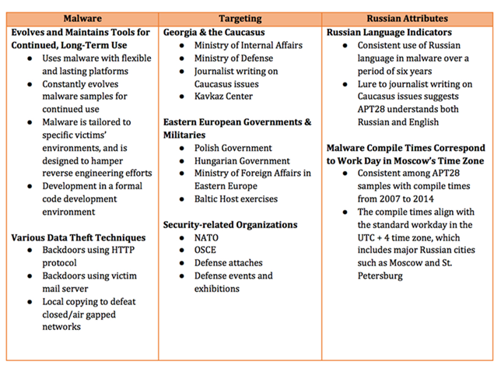
Cyber attacks 2008 – 2014 by APT28/FireEye

Slide 10
Q&A

