Slide 1

Technological and administrative aspects of the formation of the Internet critical infrastructure
Yuri Kargapolov
CEO of the Ukrainian Numbering, Addressing and Naming Operation Center, Consortium

Slide 2
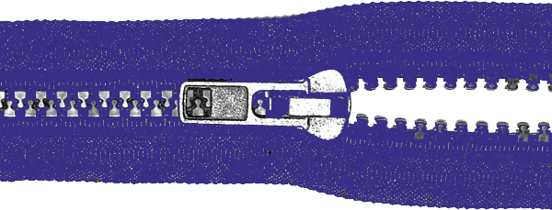
Kind of aspects on critical elements of the infrastructure
Administrtive
aspects
Technological
aspects
Economic
aspects
Legal
aspects

Slide 3

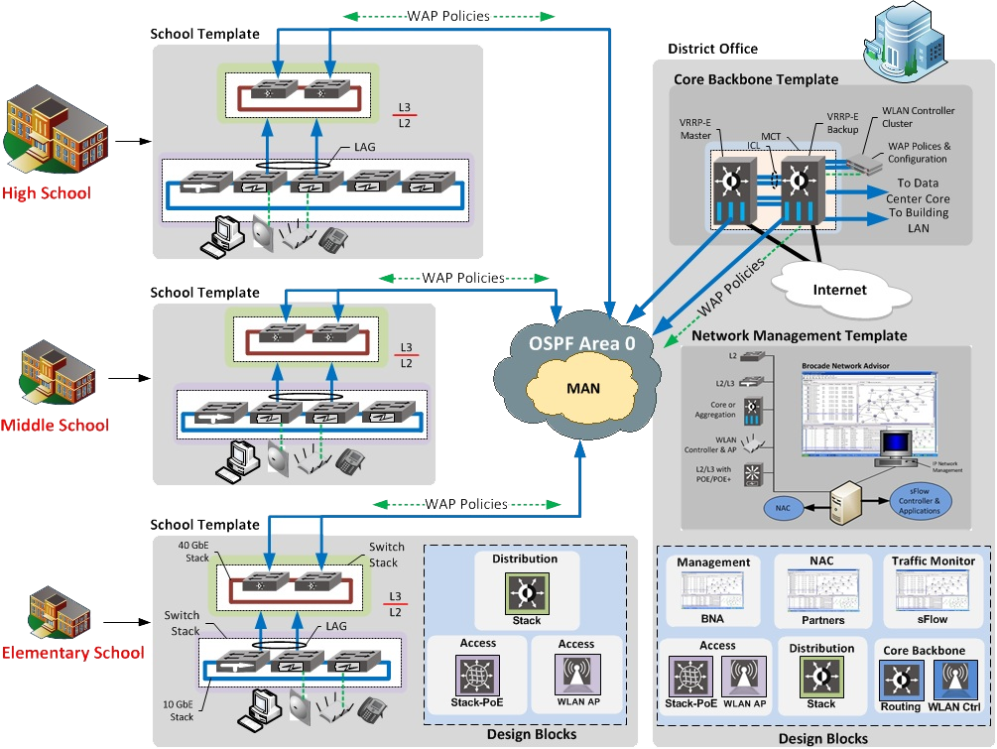
Critical elements of the electronic communication infrastructure
Administrative | Technological | Economic
Independent multistakeholders body for Internet governance | IX and interconnection policiy | Interconnection rates
Unified Rules for all market actors adopted by independent multistakeholders body | Backbone and communication channels policy | Registration charges
System of ensuring the legal stability within market actors | Routing and Passing policy | Monthly fee for access to services
Officers which has appointed by independent multistakeholders body with relevant responsibility | NNA (Numbers, DNS and IPv4 / IPv6) managing and local allocation policy | Annual and installation fee for NNA resources
Independent multistakeholders’ body for ADRP/UDRP | Access policy | Etc…
Independent multistakeholders’ body for CERT functions | Security policy
Independent trust body for fixing and investigation violations | Fixing and investigation violations policy
Screening, filtering and interception
Blocking policy

Slide 4
Internet Trilemma or Impossible Trinity
A country must change only one side of triangle and give up the opposite corner
Free capital
mobility
Administrative and legal aspects of ensuring freedom
Which country is case?
Which country is case?
U.S.
case
Hong Kong
case
At any time point
the country can
achieve only two
of the three
conditions
At any time point
the country can
achieve only two
of the three
conditions
Monetary
autonomy
Principles on national information security
Technical and technological development of infrastructure (critical elements)
Exchange-rate
managment
China
case
Which country is case?

Slide 5
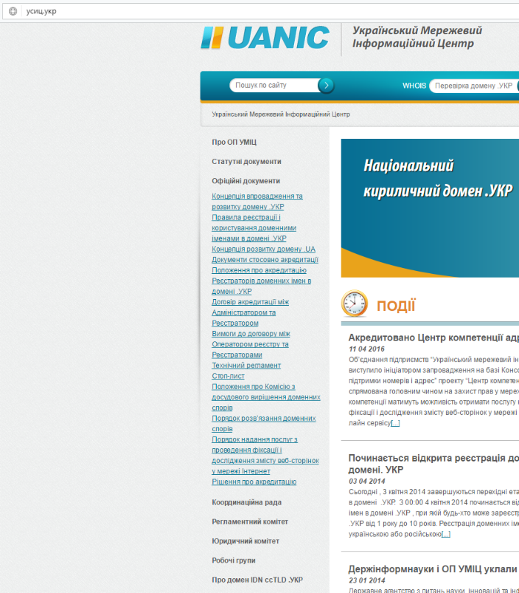
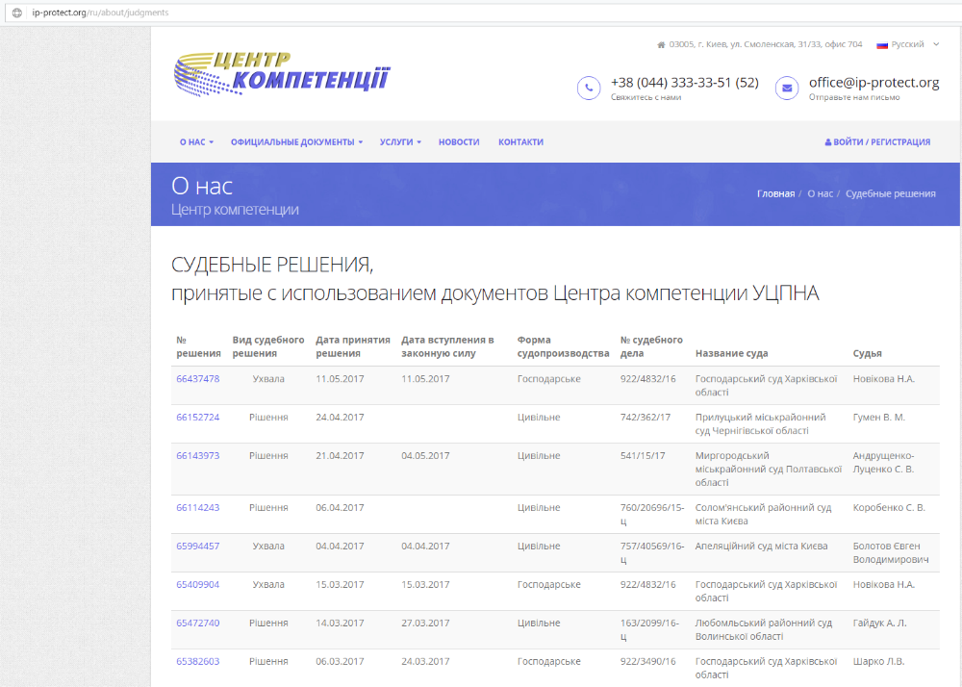
Administrative. Examples.
Unified Rules for all market actors adopted by independent multistakeholders body
Independent trust body for fixing and investigation violations

Slide 6
Thank you!
Question?
Yuri Kargapolov
CEO
UNAOC
mailto:ceo@num.net.ua
mailto:yvk@uanic.net

