Slide 1
RESPONSIBLE BEHAVIOUR OF A STATE
IN CYBERSPACE
Dushanbe, 22-23 June, 2017
Dr. ANDRII PAZIUK
Ukrainian academy of cyber security

Slide 2
Cyber-space and International law
Existent International Law is the foundation for the responsible State’s behavior in cyberspace,
Long standing international norms guiding state behavior – in times and conflict – also apply in cyberspace,
Additional understandings might be necessary to supplement them (cyberspace’s unique aspects may require clarifications in certain areas’)

Slide 3
Law of War and Cyber Operations
Cyberspace – a global domain within the information environment consisting of interdependent networks of information technology infrastructures and resident data, including the Internet, telecommunications networks, computer systems, and embedded processors and controllers
Cyber operations – the employment of cyberspace capabilities where the primary purpose is to achieve objectives in or through cyberspace

Slide 4
Cyber operations
Instrumental
Objective
(1) use cyber capabilities, such as computers, software tools, or networks
(2) have a primary purpose of achieving objectives or effects in or through cyberspace

Slide 5
Cyber operations effects
(1) Non-forcible means or methods of conducting hostilities: information gathering
(2) Amount to an attack with or without seizure or destruction of enemy property

Slide 6
Law of war principles as a General Guide
Prohibition on Cyber Operations that constitutes illegal uses of force: Article 2(4) of the UN Charter
Principle of humanity: avoid unnecessary for military purpose suffering, injury or destruction
Article 8(2)(b)(xx) of the 1998 International Criminal Court Statute (ICC):
constitutes a war crime in international armed conflicts

Slide 7
UN Charter
Article 2(4) of the UN Charter:
‘All Members shall refrain in their international relations from the threat or use of force against the territorial integrity or political independence of any state, or in any other manner inconsistent with the purposes of the United Nations’
A general prohibition, subject only to the exceptions stated in the Charter:
* self-defence
* action by the Security Council (Chapter VII)

Slide 8
Use of force in cyberspace
Evaluation of Factors:
‘In assessing whether an event constituted a use of force in or through cyberspace, we must evaluate factors including:
the context of the event
the actor perpetrating the action (attribution)
the target and location
effects and intent

Slide 9
Use of force as
Self-defense in cyberspace
Article 51 of the UN Charter
Applies against any illegal use of force
Cyber Operations that constitutes an illegal use of force – gives right to take necessary and proportionate action in self-defense
If not, - not permitted to use force in self-defense, it could be a diplomatic protest, an economic embargo, or other acts of retorsion

Slide 10
Countermeasures in cyberspace
Countermeasures are “measures that would otherwise be contrary to the international obligations of an injured State vis-à-vis the responsible State, if they were not taken by the former in response to an internationally wrongful act by the latter in order to procure cessation and reparation.”
[Draft Articles on Responsibility of States for Internationally Wrongful Acts]

Slide 11
Other Cyber Operations
Factors for evaluation if cyber operation is not an attack:
Causes only reversible effects
Causes only temporary effects
Not be conducted in a way that unnecessarily causes inconveniences to civilians or neutral persons
(defacing a government webpage; a minor, brief disruption of internet services; briefly interfering with communications; dissemination propaganda)

Slide 12
Cyber operations: jus in bello
Under International Humanitarian Law (Jus in Bello), attacks may only be directed at military objectives, while objects not falling within that definition are civilian and may not be attacked.
Pursuant to article 52 (2) of Additional Protocol I, only objects that make an effective contribution to military action and whose total or partial destruction, capture or neutralization offers a definite military advantage, may be attacked.
Protocol Additional to the Geneva Conventions of 12 August 1949, and relating to the Protection of Victims of International Armed Conflicts (Protocol I), 8 June 1977.

Slide 13
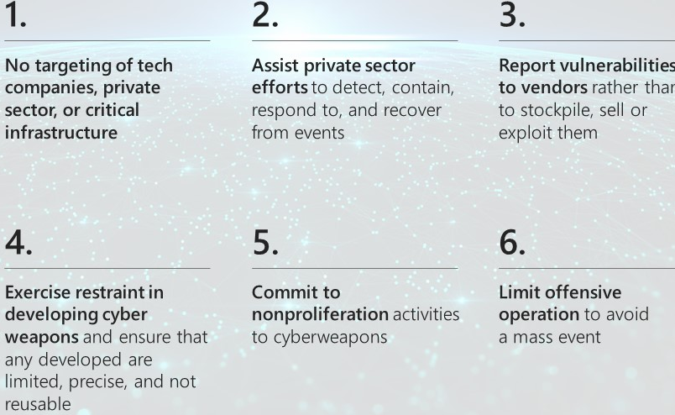
Microsoft’s Digital Geneva Convention
Brad Smith at RSA 2017: The Need for a Digital Geneva Convention
https://blogs.microsoft.com/on-the-issues/2017/02/14/need-digital-geneva-convention/

Slide 14
Attribution
Attribution capabilities of identifying the source of cyber operation
Attribution problem – managed but not resolved
United States
2014 ‘Sony hack’ (North Korea); 2016 ‘DNC hack’ (Russia)
We will be able to use our ability to attribute malicious cyber activity to push other countries toward accepting and abiding by cyber norms (the US Department of Justice)

Slide 15
Stateless Attribution
Global Cyber Attribution Consortium
‘includes broad membership across geopolitical lines to foster a diversity of perspectives and to minimize the possibility that its findings are tainted by political influence’
Davis, John S., Benjamin Adam Boudreaux, Jonathan William Welburn, Jair Aguirre, Cordaye Ogletree, Geoffrey McGovern and Michael Chase. Stateless Attribution: Toward International Accountability in Cyberspace. Santa Monica, CA: RAND Corporation, 2017. https://www.rand.org/pubs/research_reports/RR2081.html.

Slide 16
Thank you!
ANDRII PAZIUK
inet.media.law@gmail.com

